Slide 1
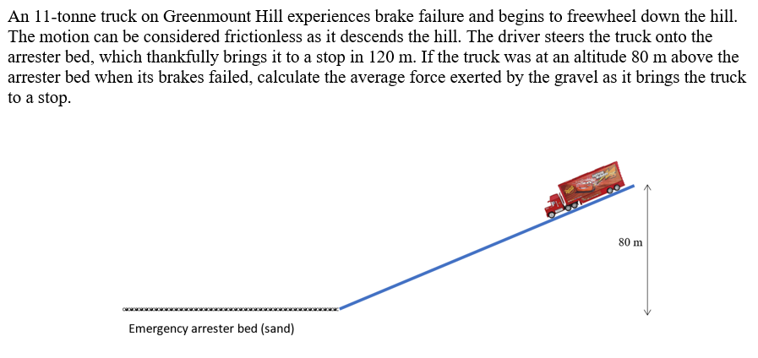
To analyse the motion of objects on inclined planes
Friction
Assume truck starts from rest
Notes:
Easiest way is to use conservation of energy:
PE at top = mgh = 8624000J
KE at bottom = 8624000J
Work done by friction = Force due to friction x distance = ~71800 N (work measured in J as is kinetic energy)
Big assumptions here: no energy lost to the surroundings due to heat or sound
Alternatively: you can use Fgsin(theta) to calculate acceleration and the velocity at the bottom of the hill. Then calculate the deacceleration in the arrester bed (v²=u²+2as). Then F_{f} =m.a

Slide 2
To analyse the motion of projectiles
Success Criteria
I can use conservation of energy to analyse motion of a projectile
I can analyse motion of projectiles launched obliquely

Slide 3
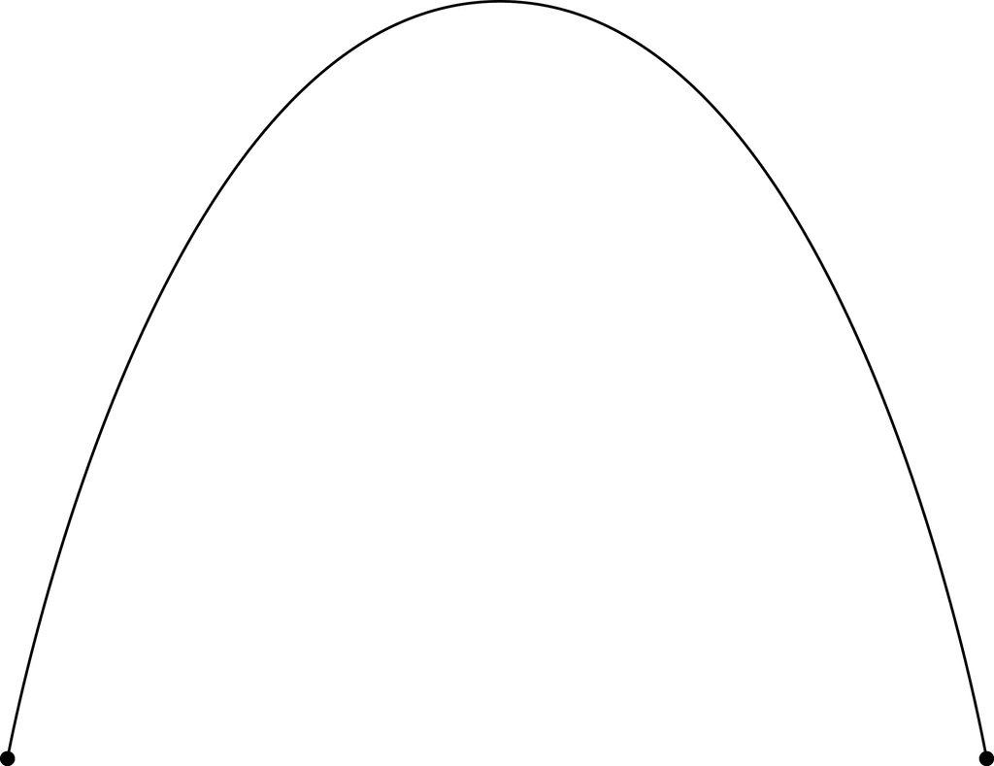
To analyse the motion of projectiles
Energy conservation
In addition to using the equations of motion to analyse projectile use, you can use the principle of the conservation of energy. Specifically, the sum of the kinetic and potential energies is always constant (assuming no air resistance).
Notes:
The sum of KE and PE at any one time is always constant
Calculate starting KE and PE
As the projectile rises, the projectile gains PE and loses KE
At the maximum height, the projectile has its maximum PE and minimum KE (zero velocity vertically)
As the projectile falls, the projectile loses PE and gains KE.

Slide 4
To analyse the motion of projectiles launched
Energy conservation
A ball of mass 500g is tossed horizontally at 5.00 m s⁻¹ from a height of 1.50m.
Using 9.80 m s⁻² and ignoring air resistance, calculate the speed of the ball as it lands.
Notes:
KE_{i} = 6.25 J
PEi = 7.35J
Total mechanical energy (initial) = 13.6 J
As it lands, PE = 0
Therefore KE(final) = Total mechanical energy initial = 13.6 J
v = 7.38 ms⁻¹

Slide 5
To analyse the motion of projectiles
Success Criteria
I can use conservation of energy to analyse motion of a projectile
I can analyse motion of projectiles launched obliquely

Slide 6
To analyse the motion of projectiles launched obliquely
Content Development
So far, we’ve been focusing on projectiles launched horizontally. Now, we will start to look at projectiles launched at an angle to the horizontal (known as ‘obliquely’).
This covers more real-life scenarios, as most things are not perfectly horizontal. Examples:
  Kicking a football
  Firing a cannon or gun at any angle other than horizontal
  Water coming out of a hose
  Sneezing
  Playing basketball

Slide 7
To analyse the motion of projectiles launched obliquely
Content Development
At each location:
Draw a free body diagram
Draw the acceleration vector
Draw the vertical and horizontal velocities
Bonus: show that the motion of the ball is symmetrical (assuming no air resistance)
Notes:
Note the starting velocity is on an angle. Resolve this into the vertical and horizontal components using trigonometry.
Draw free body diagram.
Remember: horizontal velocity is constant because there is no net force in the horizontal direction.
Question for students: show that the motion of the ball is symmetrical (assuming no air resistance)

Slide 8
To analyse the motion of projectiles launched obliquely
Content Development
Projectile motion works very similarly to vertical motion (e.g., throwing a ball straight up).
Assuming no air resistance:
The only force acting is the weight force of the object. This is pointing straight down.
Therefore the only acceleration is a downwards acceleration.
There is no change in horizontal velocity.
Vertical velocity will first decrease (as the projectile goes up, it is being decelerated), then be zero at the peak, then increase (as the projectile goes down, the acceleration due to gravity makes it go faster down).

Slide 9
To analyse the motion of projectiles
Simulation
https://phet.colorado.edu/sims/html/projectile-motion/latest/projectile-motion_en.html

Slide 10
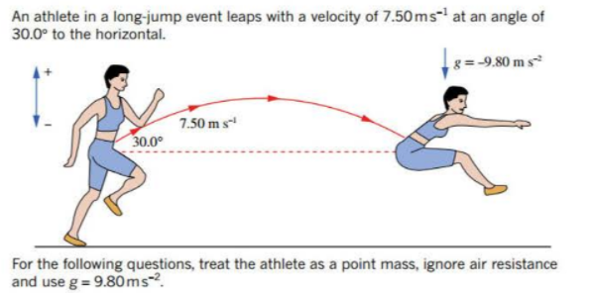
To analyse the motion of projectiles
Concept Development
Notes:
Calculate how long to fall to the ground (s = ut + ½ at²) = 22.6s
Calculate distance travelled in that time (v = s / t) = 6780m

Slide 11
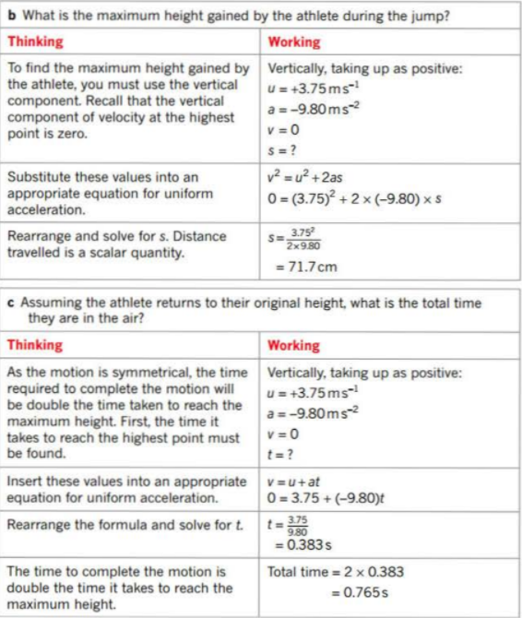
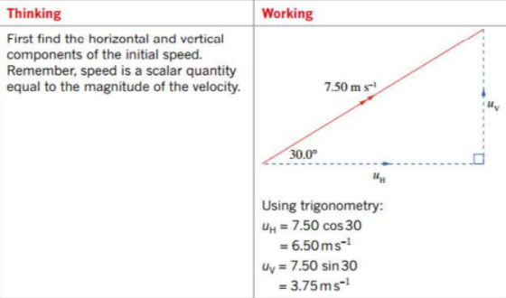
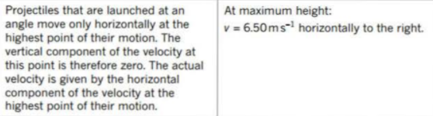
To analyse the motion of projectiles
Concept Development
Notes:
Calculate how long to fall to the ground (s = ut + ½ at²) = 22.6s
Calculate distance travelled in that time (v = s / t) = 6780m

Slide 12
To analyse the motion of projectiles
Oblique launch
A golf player hits a golf ball with an initial velocity of 45.0 ms⁻¹ angled at 32.0º above the horizontal.
Calculate the time the ball takes to reach its maximum height
Calculate the maximum height achieved by the ball
Calculate the horizonal displacement of the ball when it lands
Notes:
Draw the initial velocity and resolve it into its vector components
V_{v} = 0 at the peak of the path
v = u + at
u = 45sin(32)
solve for t: t = 2.43s
b) s= ut+0.5at² (where t = 2.43s). s = 29.0m
c) s_{h} = u_{h} t where t = 2.43s * 2 (as the motion is symmetrical)
s = 186m

Slide 13

To analyse the motion of projectiles
Terminology
Time of flight Time that projectile is in the air
Range Total horizontal distance between start and end
Maximum height Highest vertical displacement achieved
Maximum height
Time of flight
Range
Notes:
Draw the initial velocity and resolve it into its vector components
V_{v} = 0 at the peak of the path
v = u + at
u = 45sin(32)
solve for t: t = 2.43s
b) s= ut+0.5at² (where t = 2.43s). s = 29.0m
c) s_{h} = u_{h} t where t = 2.43s * 2 (as the motion is symmetrical)
s = 186m

Slide 14
To analyse the motion of projectiles
Catapult and trebuchet simulations
https://www.youtube.com/watch?v=cs8gamnMIS0&ab_channel=SmithsonianChannel
https://www.youtube.com/watch?v=9-Hwxw4fgqk&ab_channel=ScienceChannel
https://sigmazone.com/catapult/
https://ophysics.com/k8.html
https://ophysics.com/k9.html
https://virtualtrebuchet.com/

Slide 15
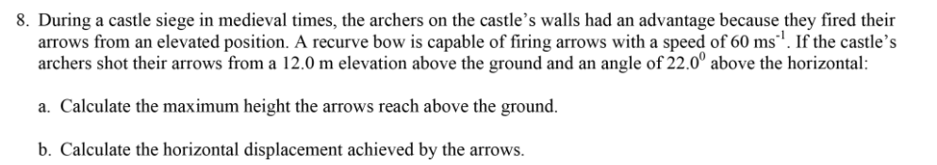
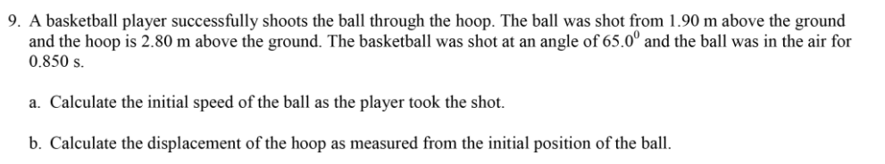
To analyse the motion of projectiles launched obliquely
Homework

Slide 16
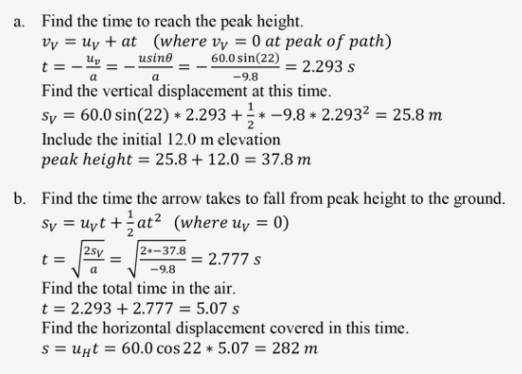
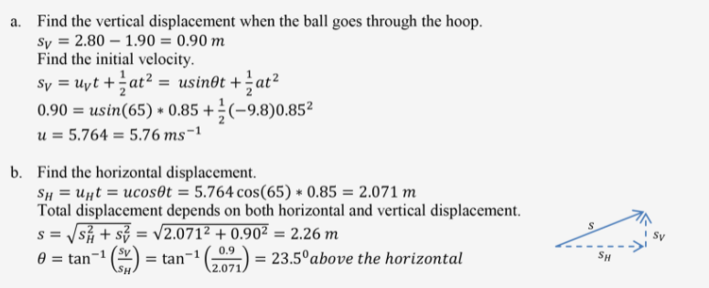
To analyse the motion of projectiles launched obliquely
Homework Answers
Q8
Q9

